Slide 1
EH - TASK 3
Showing simple vulnerability

Slide 2
STEPS:
Step 1: Go to the website -http://testasp.vulnweb.com/
Step 2: On the top menu you will find a search option.
Step Click on it and you will be prompted with the Search box:.
Step 4: Enter your desirable payload in the search box
Step 5: Enter the “payloads for XSS” (cross site scripting).
Step 6: And now click on the search button
Step 7:Now you will be prompted with a alert box on your window.
Step 8:Hence the payload you entered is executed . and we had found that it is vulnerable

Slide 3
EFFECTS
EFFECTS:
XSS can have huge implications for a web application and its users. User accounts can be hijacked, credentials could be stolen, sensitive data could be exfiltrated, and lastly, access to your client computers can be obtained.

Slide 4
To Avoid Xss:
To Avoid Xss:
Sanitize user input:Validate to catch potentially malicious user-provided input. Encode output to prevent potentially malicious user-provided data from triggering automatic load-and-execute behavior by a browser.

Slide 5
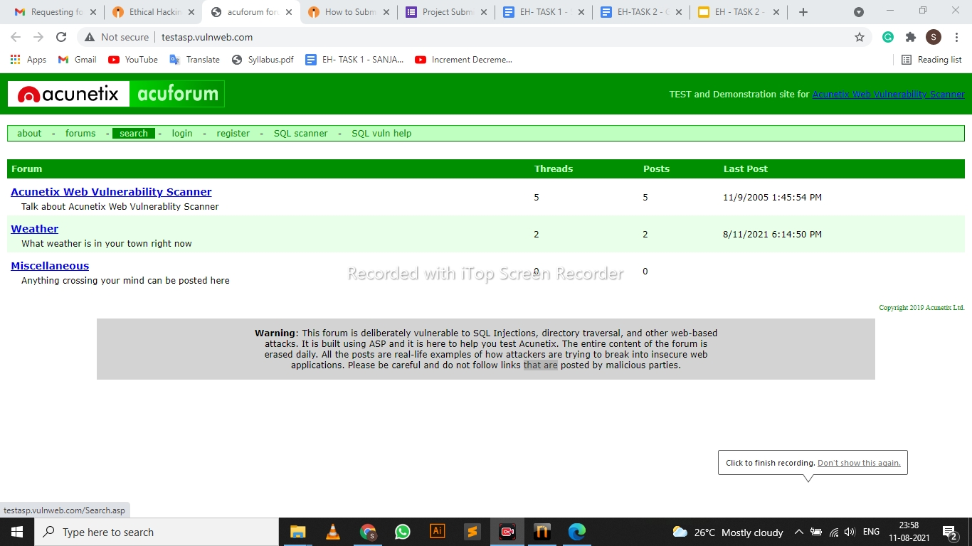
Screenshots :

Slide 6
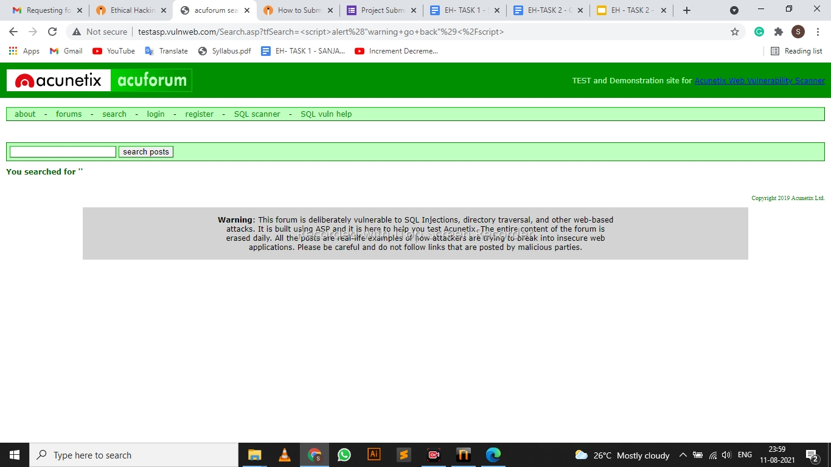

Slide 7
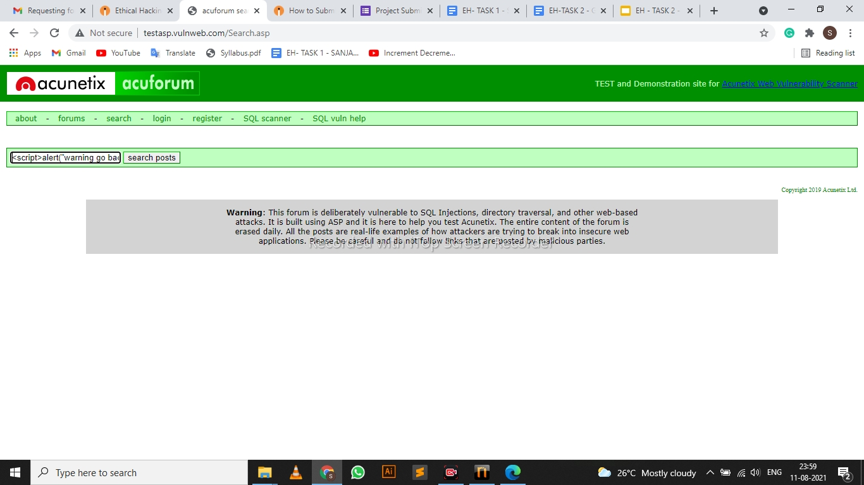

Slide 8
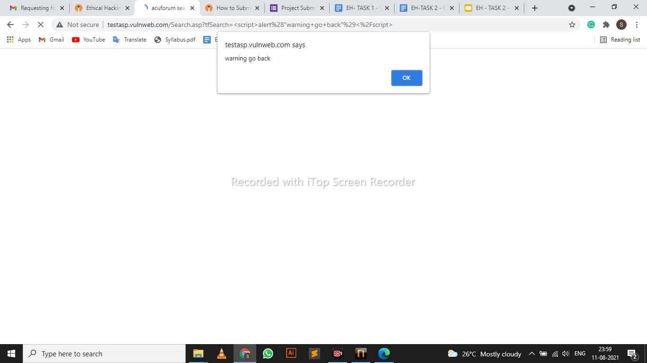

Slide 9

VIDEO LINK:
https://drive.google.com/file/d/1ABu4l5Kzuvi7vhyPeYmD1-248SRfYjxH/view?usp=sharing

